Slide 1



PT. LORENS IMPSUM
TOTAL LOGISTICS SOLUTIONS
BUSINESS PRESENTATION
We bring unique combination of experience, service, and technology for your new goals

Slide 2

COVER LETTER
Anang Fahmi Syarif
With a full team of logistics , we provide better solution for your supply chain process dan benefit. Our unique combination of experience, service, and technology allows us to provide logistics services that offer a high degree of reliability while remaining cost-effective.
Head Business Development

Slide 3

Agenda
01
06
Project Context
Certifications
02
07
About Us
Our Team
03
08
Our Services
Client Testimonial
04
08
We Serve Industries
Contact Us
05
Our Logistics Process

Slide 4

Project Context for Logistics Solutions
What you Require
We have learned from our previous discussion about the need for logistics solutions for your company
Logistics Services
Warehouse Management
A logistics service company with multi years working contract
Warehouse services covering 10 thousand square meters with full support and bonded facilities
Intersular Transportations
Distribution Management
To transport goods by means of road and air transportation service
Distribute goods to customers according to their needs and requests
Our Objective
To provide a complete logistics service solution with activities like inbound logistics, procurement, outbound logistics and bonded facilities.
Logistics Expert
Time & Quality
Experienced supply chain experts and logistics operations
Punctuality and maintain quality and contribute to circular economic
Cost and Benefit
We will always focus on reducing costs and increasing benefits for your business

Slide 5
Logistics Solutions We Offer
Warehousing & Distribution
Solutions
Customs and
Bonded Services
Reverse Logistics
Trade Automation
Services
Last Mile Pickup
and Delivery
Freight Forwarding
Retail Sales
and Distribution
Road Freight
Total Solutions
We offer better solution for your Suplly chain & Logisitcs
Supply Chain
Solutions
System And Technologies

Slide 6
Logistics Solutions for Your Supply Chain
End to End Solutions
Information Flow Platform
Primary Product Flow Logistics
Reverse Product Logistics
Expert Consultation Support
Delivery Order Management
Billing Management
Warehouse and Inventory Management
Tracking & Traceblity
360⁰ Information
Shipment Handling
Warehouse and Inventory Handling
Multimoda Transportation
Transportation Support
Contract Logistics
Circular & Recyling Logistics
Replacement Management
Return of Repair
Logistics Management Support
Forecast & Trend for Logistics
Improvement & Quality Management
6PL

Slide 7










Industries We Serve for Logistics Solutions
Freigt Forwading Evolution for many Industries
Automotive
FMCG
High-Tech
Industrial
Oil & Gas
Marine
Logistics
Pharma
and Healthcare
Retail
and eCommerce
Emergency
and Relief
Forest
Products
Hotel
Logistics
Foodservice
Logistics

Slide 8
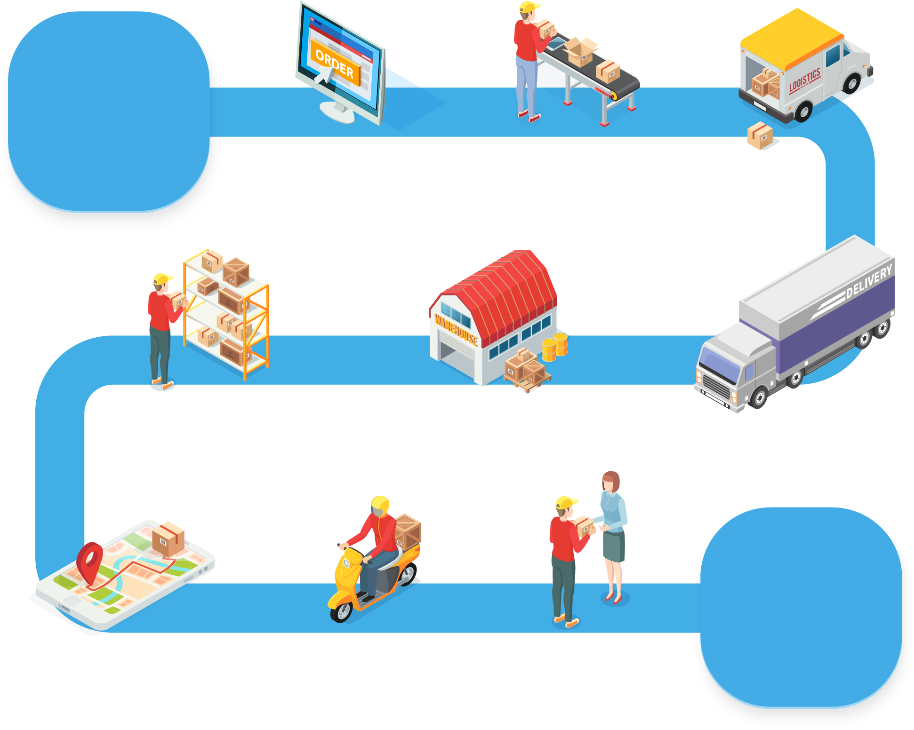
Our Logistics Process
Inventory
Management
Supplier
Order Processing
Warehouse/
Distribution Centre
Mode Of
Transportation
Customer
Deliver to
Customer

Slide 9

Your Investment for Freight Forwarding Business
Description
Description
Tarff
Warehousing Solutions | M3/Per month
Last Mile Pickup and Delivery | M3/Per month
Retail Sales & Distribution | M3/Per month
Customs Services | M3/Per month
Trade Automation Services | M3/Per month
Freight Forwarding | M3/Per month

Slide 10
About Us
Digital Logistics Solutions
Nullam eu tempor purus. Nunc a leo magna, sit amet consequat risus. Etiam faucibus tortor.
Bring right solutions and distribution with ease
Vivamus quam dolor, tempor ac gravida sit amet, porta fermentum magna. Aliquam euismod commodo nisl, vel luctus lorem fermentum quis.
Who we are
ABC is a leading worldwide provider of transportation, warehousing, global logistics and supply chain solutions.
Where Are We
We are Surabaya based logistic company founded in 2009 in by Muh Tanto .
Business
Our information systems provide up to the minute tracking and all historical data associated with a shipment so that a clear picture can be delivered to our customers at all the times.

Slide 11
Contact Us
Address
Email
Rungkut Makmur Square
Surabaya, East Java
Indonesia,
support@gmail.com
Contact Number
Webiste
+62 81231411833
http://www.google.com

Slide 12



www.solog.id

